Slide 1
Community Leader Information Session
Communities of Practice

Slide 2
Community of Pratice Overview
ACUI features 22 Communities of Practice (CoPs) actively contributing to the development of a dynamic and supportive online learning community for its members. These CoPs, integral to our mission, are specialized groups that unite professionals sharing a common passion for different aspects of education. While each community is unique, all adhere to sets of best practices within specific areas, and they may be based on professional roles (e.g., Facilities & Operations) or identity (e.g., LGBTQ+).
Administration, Finance, & Auxiliary Management
Campus Programs & Events
Catholic Colleges
Diversity, Equity, and Inclusion
Emergency Management
Facilities & Operations
Graduate Students & New Professionals
International Student Unions and Student Life
Leadership & Service Education
LGBTQIA+
Marketing for the Campus
Multi-ethnic Professionals & Allies (COMP)
On-Campus Recreation & Leisure
Seasoned Professionals & Retirees
Small School
Student Basic Needs
Student Employee Supervisors
Student Organization Advisors
Sustainability
Technology
Urban Unions
Women's Leadership

Slide 3
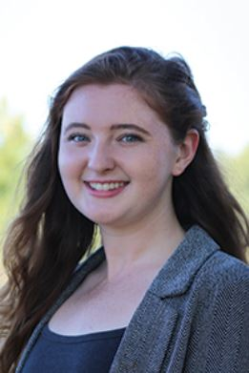
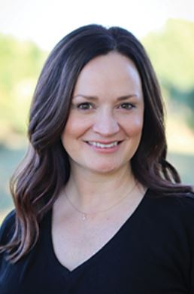
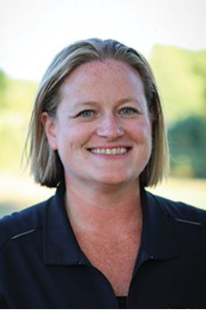
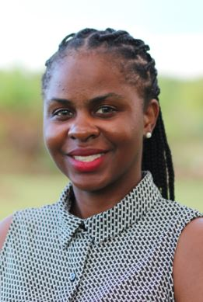
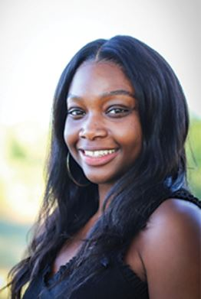
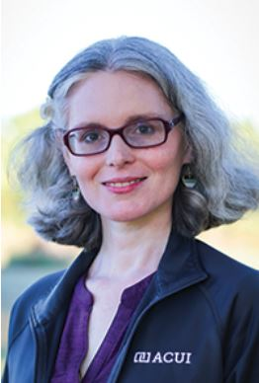
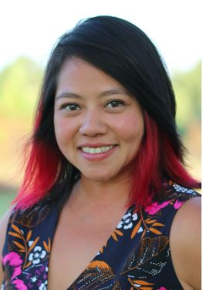
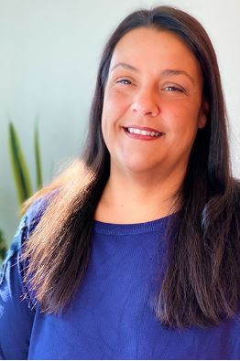
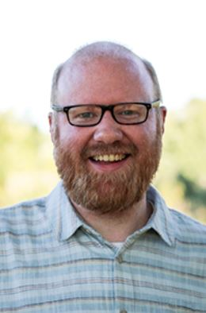
Community Liaisons
Taylor Blechschmid
Leadership & Service Education
Amy Morgan
Emergency Management
Technology
Liz Stringer
Marketing for the Campus
Savitra Dow
Graduate Students & New Professionals
Seasoned Professionals & Retirees
Victoria Moulterie
Women's Leadership
International Student Unions
Urban Unions
Catholic Colleges & Universities
Small Schools
Scarlett Winters
Student Employee Supervisors
Stacey Givens
LGBTQIA+
Multi-Ethnic Professionals & Allies
Diversity, Equity, & Inclusion
Student Basic Needs
Kim Pho
Facilities & Operations,
Sustainability
Shanna Kinzel
Student Organization Advisors
Campus Programs & Events
On-Campus Recreation & Leisure
Justin Rudisille
Administration, Finance, & Auxiliaries

Slide 4
Over 23,000+
Community of Practice Members

Slide 5
Commuity Leaders
Community Leaders are the main contact for your community of practice. They contribute to the educational and community-building missions of the Association through actively engaging members of their assigned communities in education and networking around a focused area, with the goal of improving and sharing knowledge.
Community Leader Responsibilities :
Being the main contact for your community of practice
Attend quarterly Community Leader meetings
Monitoring the forum for your community of practice
Initiating recruitment and promotion efforts to bring visibility to the community of practice
Serve as the primary point of contact for planning, promoting, and facilitating
Contributing to the educational goals of the community of practice through educational sessions, etc
Show appreciation to community members

Slide 6
Why Become A Community Leader?
Professional Growth Opportunities
Enhanced Leadership & Transferable Skills
Embrace the opportunity to diversify your skill set, gaining valuable experiences that extend beyond the confines of your traditional professional role
The responsibilities of a community leader, such as facilitating discussions, resolving conflicts, and organizing events, provide a platform for the development of strong leadership skills
Influence and Impact
Expanded Network
Through strategic initiatives and thoughtful leadership, you can make a positive impact on the lives and experiences of community members, contributing to the growth and success of the Communities of Practice
Expand your network and enhance personal connections. This allows you to open doors to new opportunities, collaborations, and valuable relationships within and outside the community of over 23,000 members..

Slide 7
Conversations with Community Leaders

Slide 8
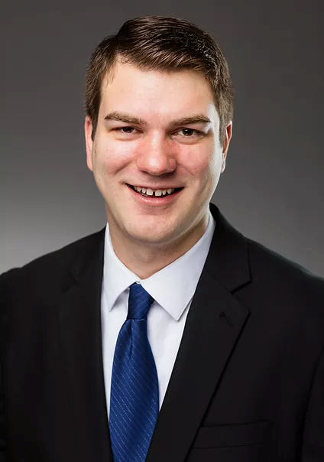
Meet: Caleb Eubanks Title: Marketing & Communication Manager, Elliott Student Union School: University of Central Missouri
Click Here to Watch Video
Community of Practice Leader for: LGBTQIA+

Slide 9
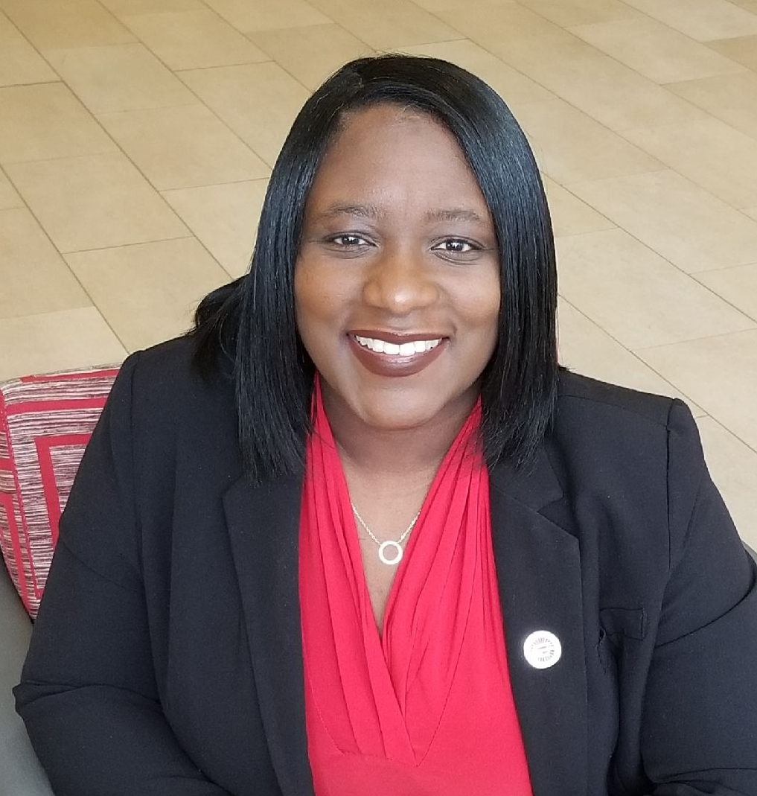
Meet: Yakima Melton Title: Director, Student Unions and Centers School: Arizona State University
Click Here to Watch Video
Community of Practice Leader for: Multi-ethnic Professionals & Allies (COMP)

Slide 10
Community Leader Application Timeline
JAN
22
FEB
5
APR
5
MAY
TBD
Learn more about being a Community of
Pratice Leader
Applications Open
Applications Close
Interviews
MAY
TBD
JUN
1
JUN
TBD
JUN
2025
Community of Practice Leader Selections
Community Leader
Term Begins
Community Leader
Virtual Training
Leader terms end but the position can be extended if you are interested in continuing.

Slide 11
2024 Communiity Leader Openings

Slide 12
Administration, Finance, & Auxiliary Management
Graduate Students & New Professionals
On-Campus Recreation & Leisure
Need: (2) Leaders
Need: (2) Leader
Need: (2) Leaders
Campus Programs & Events
International Student Unions and Student Life
Small School
Need: (2) Leaders
Need: (1) Leader
Need: (2) Leaders
Catholic Colleges
Leadership & Service Education
Student Organization Advisors
Need: (2) Leaders
Need: (1) Leader
Need: (1) Leader
Emergency Management
LGBTQIA+
Sustainability
Need: (2) Leaders
Need: (2) Leaders
Need: (2) Leaders
Marketing for the Campus
Technology
Need: (2) Leaders
Need: (2) Leaders

Slide 13
The Administration, Finance, & Auxiliary Management Community Group is a dedicated network of professionals and enthusiasts passionate about optimizing organizational efficiency. The community focuses on providing directors, assistant directors, and others in the administration, finance, and auxiliaries side of student affairs a place to network, share resources, and work together to improve campus community.
Administration, Finance, & Auxiliary Management
Back to Community Openings

Slide 14
The Campus Programs & Events Community Group is a dynamic network bringing together individuals involved or interested in creating vibrant and engaging experiences on campus. Whether you're an event planner, program coordinator, or simply enthusiastic about campus life, this community provides a platform for collaboration, idea-sharing, and professional growth. Help find resources to support event planning and programming needs.
Campus Programs & Events
Back to Community Openings

Slide 15
The Catholic College is a dedicated network for professionals working in religious institutions, offering a collaborative space to navigate the unique challenges and opportunities within our community. Whether you're a faculty member, staff, student, or alum, our group is designed to foster mutual support, knowledge-sharing, and collaboration. Through open discussions, shared experiences, and collective problem-solving, help strengthen the professional connections within this community.
Catholic Colleges
Back to Community Openings

Slide 16
The Emergency Management in College Unions Community is dedicated to examining both long- and short-term, action-based strategies aimed at fostering a constructive approach to emergency management. This community gathers professionals to discuss best practices in emergency preparedness, general safety measures, response tactics, and effective training specifically tailored for college unions and campuses. Help lead this community to enhance emergency management practices within educational institutions, sharing insights and promoting a safer environment for all
Emergency Management
Back to Community Openings

Slide 17
This community’s primary focus is on mutual support for career growth. They facilitate connections with experienced members in the field who generously contribute to their professional development. Help lead this community to harness the power of collaboration, mentorship, and shared experiences and navigate grad students and new professionals career paths.
Graduate Students & New Professional
Back to Community Openings

Slide 18
This community’s focus is to actively strive to develop global competence and empower the individual within the ACUI community. They strive to develop global competence and empower the "I" in ACUI.
International Student Unions & Student Life
Back to Community Openings

Slide 19
Campus Leadership Development Community actively engage in finding and sharing valuable resources, exchanging ideas, and fostering discussions related to the growth of leaders on campuses. They collaborate to inspire, empower, and cultivate effective leadership development strategies. Help shape the future leaders of our campuses through knowledge-sharing and meaningful conversations.
Leadership & Service Education
Back to Community Openings

Slide 20
The LGBTQIA+ Community Group is a vibrant and inclusive gathering that provides a supportive space for individuals regardless of your pronouns, sex, gender expression, sexual orientation, or sexual preferences. Allies and topics of intersectionality are welcome, too. This group fosters connections, understanding, and solidarity among its members, promoting a sense of belonging and acceptance. Lead a community that embraces authenticity, respect, and unity.
LGBTQIA+
Back to Community Openings

Slide 21
This space is dedicated to sharing resources, ideas, questions, and addressing issues related to all things marketing on campus. Whether you're seeking inspiration, have valuable insights to share, or need help navigating marketing challenges, this community is your go-to platform. Help lead a collaborative space where marketing professionals on campus can connect, learn, and thrive together. Let's enhance our marketing efforts and contribute to the vibrancy of campus life!
Marketing for the Campus
Back to Community Openings

Slide 22
This community is focused on sharing best practices, seeking advice on new equipment or challenges, exchanging training resources, and networking with others involved in campus-based recreation and leisure. Lead a community that thrives on the collective knowledge and experiences of individuals passionate about enhancing on-campus recreational activities
On – Campus Recreation & Leisure
Back to Community Openings

Slide 23
This community focuses on the needs and challenges faced by individuals working at small colleges and universities, specifically those with less than 5000 Full-Time Equivalents (FTE). This community is a platform for sharing insights, discussing tailored solutions, and building connections with peers who understand the nuances of working in a smaller academic environment.
Small Schools
Back to Community Openings

Slide 24
This community is dedicated to advisors of student organizations. Here, you can discover and share valuable resources, engage in discussions related to student organizations, and connect with fellow advisors to build a collaborative community where expertise is exchanged, challenges are addressed, and meaningful connections are formed.
Student Organization Advisors
Back to Community Openings

Slide 25
This community is a go-to hub for finding and sharing resources, engaging in discussions, and exchanging tips related to sustainability on campus. Help lead and Connect with like-minded individuals who share an interest in promoting sustainable practices
Sustainability
Back to Community Openings

Slide 26
This community is a dedicated space for tech enthusiasts to come together, share insights, and explore the ever-evolving landscape of technology within the academic setting If you have an interest in audio-visual, digital signage, software, hardware, event technology, theatrical lighting, streaming video, production, emerging technologies, or any other technology on the college campus, you are in the right place.
Technology
Back to Community Openings

Slide 27
Thank You!
WE LOOK FORWARD TO RECEIVING YOUR APPLICATION
Applications open Monday, February 5, 2024
For additional questions, please be sure to contact your Community of Practice Liaison or Savitra Dow

